Slide 1
Building Container Images For Microservices

Slide 2
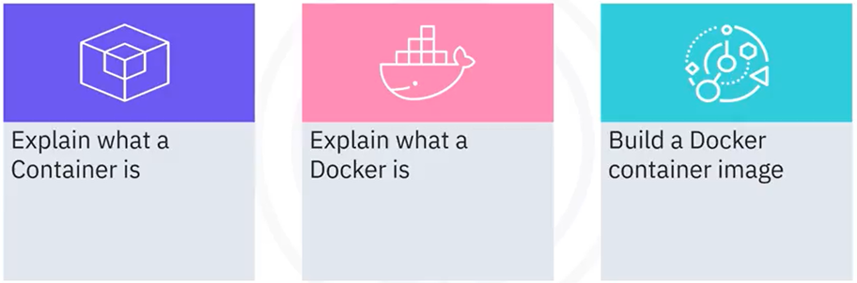
What you will learn

Slide 3
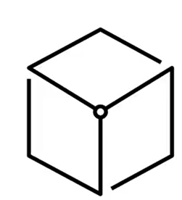
What is a Container
• Standalone and all-inclusive executable software
unit
• Run anywhere
• Small, fast, and portable
• Perfect match for Microservices architecture

Slide 4

Docker
• Popular platform for building and running
containers
• Provides a straightforward way to build and run
containers
• Main container technology used in IBM Cloud
Engine

Slide 5
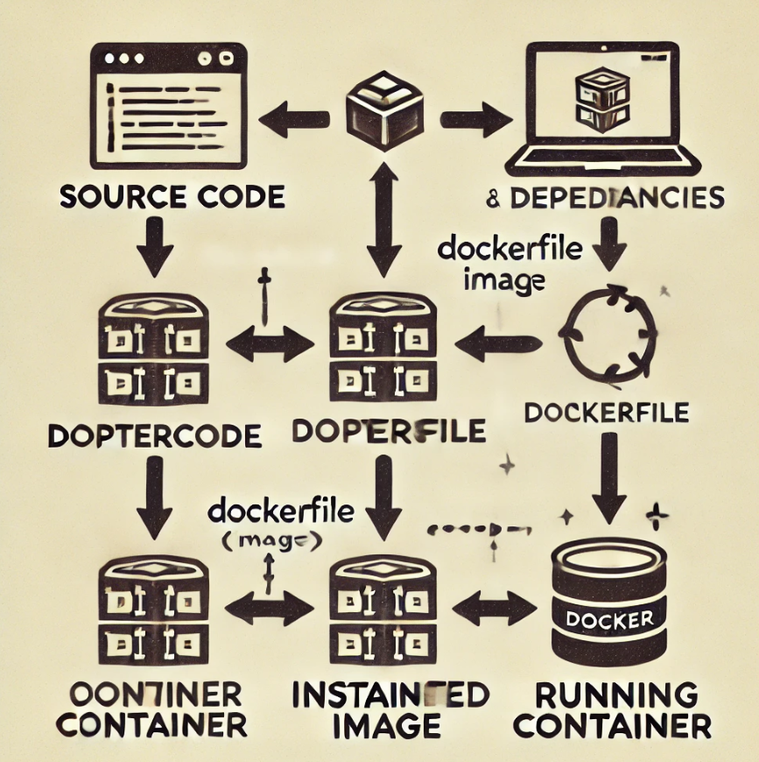
Build a Docker container image

Slide 6
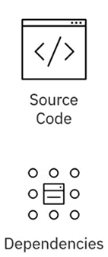
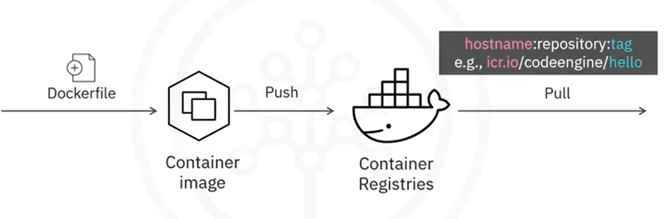
Push to container registry

Slide 7
Recap
In this video, you learned that:
• A container is a standalone, executable software unit
packaged with all its dependencies.
• Docker is a very popular container-building and running
platform.
• You can compose a Dockerfile to instruct the Docker platform
to build a container image.
• After the container image is built, it can be pushed to the
container registry and then be pulled by its image name.

